Slide 1

Announcements
PS1 (group) due Sunday (1/22)
Discussion 1 due Sunday (1/22)

Slide 2
Predictive Analytics for Business Strategy

Slide 3
By the end of this class, you should be able to:
Conduct and explain the results of a single population and two population hypothesis test. (we’ll be using t tests)
Explain regression output and the hypothesis test(s) is/are being conducted when you run a linear regression.
Explain what it means for a coefficient to be statistically significant.
Discuss why a significant effect of x on y may not imply a causal impact of x on y.

Slide 4
Hypothesis tests in regression
Most of you have run a linear regression before.
What you may or may not have realized was that you were likely conducting at least one hypothesis test each time your ran a linear regression.
We will eventually focus far more on regression, but because of this overlap, it is very important we understand t tests first.

Slide 5
t tests
What is a t test?

Slide 6
t tests
What is a t test?
The t-test is any statistical hypothesis test in which the test statistic follows a Student's t-distribution under the null hypothesis.
If we’d known the population variance, we would use the normal rather than the t distribution.

Slide 7
t tests in Stata
There are different types of t tests:
Single sample
Compares our sample mean to hypothesized value
Often zero (test for “significance”)
Two sample
Often a test for equality

Slide 8
Single sample t test (common in regression)
In a single sample t test, we are testing whether we are far enough away from the null hypothesis to reject it.
Null hypothesis is zero:
Are we far from zero? (in regression, is it significant?)
Null hypothesis is some other value:
Maybe the maximum allowable amount of arsenic in a liter of water is x. We might test if we can reject being at or below x.

Slide 9
Two sample t test
In a two sample t test, we are testing whether one group is far enough away from another group.
Suppose, we gave one group a treatment and another a placebo.
We might want to see if the group with the treatment performed significantly better/worse than the other.
Very often, null hypothesis is zero:
Here we are taking the average of each sample and subtracting it. Then we see if that difference is far from zero.

Slide 10
Two sample t test – special cases
There are other special cases of two sample t tests, such as when the observations are paired (same individuals, but before & after).
This is not something we need to focus on for our understanding of t tests though.

Slide 11
Stata
Next we’ll use a sample of some scraped data from Airbnb listings in Austin, TX.
First, let’s use a couple basic commands that give us info on the variables
describe
Gives a description of all variables
We can use describe price if just interested in price
summarize
Can also enter variable(s) after. Gives summary stats.
Note commands are case sensitive.

Slide 12
Stata
Let’s start with our t tests:
Using the dropdown menu (and then take note of the commands):
Statistics -> Summaries, tables, and tests -> Classical tests of hypotheses -> t test (mean-comparison test)

Slide 13
Single sample t test example
Suppose we think the average number of bedrooms in a listing is 2.
We could test whether the average from this sample of data is significantly different from 2.
Choose One Sample
Variable name = bedrooms
Hypothesized mean = 2

Slide 14
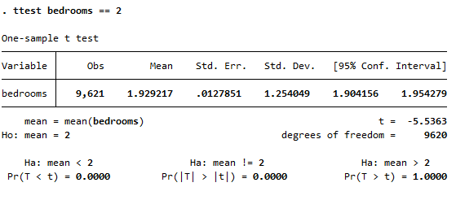
Single sample t test example output
Could we reject the null hypothesis here?

Slide 15
Significantly different
We’ve used the expression “significant” or “significantly different” multiple times now.
Typically, it is whether something is significantly different from zero.
In the last example, we were asking if a coefficient was significantly different from 2.
Was it? And how would you explain significance?

Slide 16
Two sample t tests
In order to do a two sample t test, there needs to be something that can be split into two groups.
Treated/untreated
High/low
Type A/Type B (assuming only two) types
We could create a variable that is 1 if an observation is above average and 0 if not.
Such as the high/low case.
Here we’ll just use the entire_home variable since it is split into two groups (yes, no).

Slide 17
Two sample t test example
Here we will test whether the average price of having the entire place is the same as not having the entire place.
Two-sample using groups
Variable name = price
Group variable name = entire_home
Unequal variance checked

Slide 18
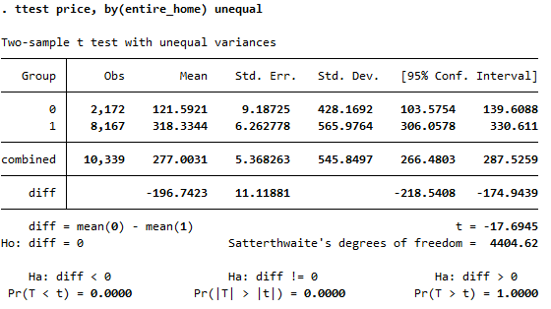
Two sample t test example output
Could we reject the null hypothesis here?

Slide 19
t tests in linear regression
Testing whether avg number of bedrooms is equal to 2 is quite different from what we actually do.
We’re often running a regression and want to understand the relationship(s) that uncovers.
The reason we are so interested in t tests is that we do them every time we run a regression.

Slide 20
Regression and hypothesis tests
Let’s use the same data (and same two variables), but this time, let’s run the following regression:
reg price entire_home
Interpret the following:
Coefficient on entire_home (& std. error, t, p, CI)
Does p-value tell us if effect is significant?
What can/can’t we say about causality here?

Slide 21
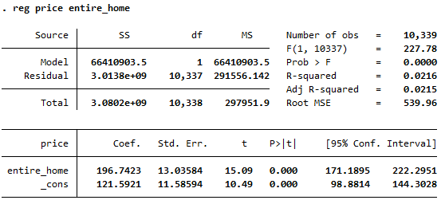
Simple regression example

Slide 22
R-squared
R squared is said to tell us how much of the total variation in Y can be “explained” by the variation in X.
I dislike the use of “explained” here.
Think of this instead as a measurement of correlation and how closely the other variables move with Y.
This has a lot of value in some cases, but much less in causal inference.

Slide 23
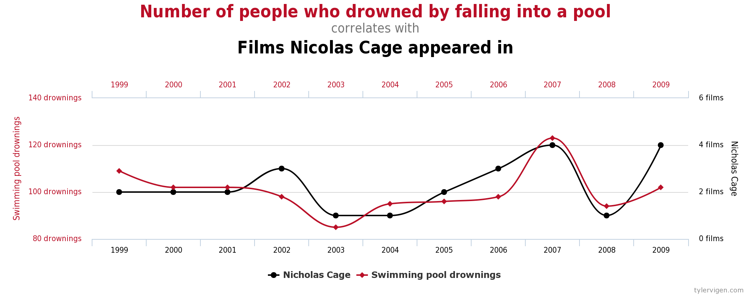
Example of very high R-squared
If we regressed # of people drowning by falling into a pool on # Nicholas cage films, we’d see a high R-squared over these years.
Does this imply other factors have little/no role?

Slide 24
What else is going on?
Going back to price and entire_home:
Since this is observational data (how can we tell that?), we can’t directly use it to infer a causal impact of entire_home on price.
Why not?

Slide 25
Let’s add additional variables
Run the following regression and interpret the output:
reg price entire_home beds bedrooms

Slide 26
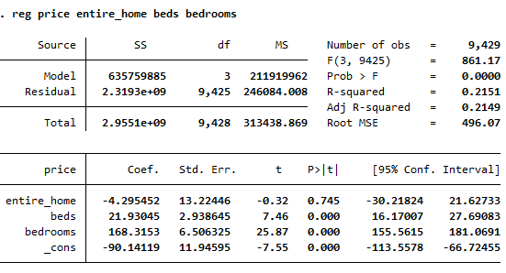
Let’s add an additional variable
What do the coefficients tell us?
What does/doesn’t this say about causality?

Slide 27
Hypothesis tests in regression
Ignoring the constant (y-intercept) term (_cons), how many hypothesis tests were conducted in the last regression?
In how many of those (ignoring constant), would we reject the null hypothesis at a 95% confidence level?

Slide 28
NYC Taxi Data example
For this example, we’ll use NYCTaxi.dta
Make sure you use file -> open
Since it is a .dta file, which is specific to Stata

Slide 29
NYC Taxi Data example
Let’s run a few regressions and discuss:
reg fare_amount tolls_amount
reg tip_amount tolls_amount

Slide 30
NYC Taxi Data example
Let’s consider some other factors that might impact tip_amount:
reg tip_amount tolls_amount fare_amount trip_distance passenger_count
How can we interpret this?
Anything surprising here?

Slide 31
Payment by credit?
What do we see among passengers that pay using a credit card?
reg tip_am payment_credit
reg tip_am payment_credit fare_amount tolls_amount
Can we interpret either of these causally?
Can you think of any differences between those who pay with a credit card and those who don’t?

Slide 32
Wrapping up
We’ve seen how one or more X variables move with a Y variable (holding other X variables fixed).
We can describe whether that relationship is statistically significant given our sample.
However, we will have to learn more to be able to make causal claims when using observational data.

